Slide 1
PROACTIVE DISASTER DETECTION
PIP2001 Capstone Project
VIVA VOICE
Batch Number:ISD-07
Roll Number | Student Name
20211ISD0004 | E RAHUL
20211ISD0039 | ABHI C N
20211ISD0019 | V NARENDRA
20211ISD0006 | BODDU KUSHWANTH SAI
Under the Supervision of,
Prof. Jacob Augustine
Professor
School of Computer Science and Engineering
Presidency University

Slide 2
Introduction
Natural disasters have far-reaching consequences, impacting lives, infrastructure, and the environment. To mitigate the damage and enhance disaster preparedness, technology can play a pivotal role in early detection and efficient management. This project focuses on disaster prediction, aiming to detect high probabilities of large-scale natural disasters by processing satellite data alongside human-generated inputs. The system utilizes this data to not only predict the likelihood of imminent disasters but also model the dynamics of post-disaster spread. By understanding these patterns, decision-makers can improve disaster management, leading to timely responses and resource allocation during crises.This project aims to predict the likelihood of large-scale disasters by processing satellite and human-generated data. By using this data, the system can serve as an early warning tool while also modeling the post-disaster spread dynamics, which is crucial for effective disaster management.

Slide 3
Literature Review
Disaster prediction using machine learning (ML) models has become a critical area of research due to the increasing frequency and intensity of natural disasters. Researchers leverage various algorithms, datasets, and computational techniques to improve the accuracy of predictions, enabling timely interventions and reducing risks to human life and infrastructure. This literature review explores the significant advancements in disaster prediction using ML for hurricanes, earthquakes, and floods.
1. Hurricanes Prediction
Hurricanes are complex meteorological events influenced by multiple factors such as temperature, humidity, and wind speed. Predictive models often use large-scale meteorological datasets to forecast hurricane paths and intensities.
Techniques:
Random Forest, Gradient Boosting, and Neural Networks are commonly applied due to their ability to handle non-linear relationships.
Atmospheric data, such as sea surface temperatures and air pressure gradients, are key predictors.
Notable Studies:
A study by Emanuel et al. (2005) highlighted the role of ocean heat content in hurricane intensification.
More recent research has utilized ensemble learning techniques, improving forecasting accuracy by combining predictions from multiple models.
2. Earthquake Prediction
Earthquake prediction remains one of the most challenging tasks due to the stochastic nature of seismic events. ML has been instrumental in analyzing patterns in seismic data to estimate the likelihood of future earthquakes.
Techniques:
Logistic Regression and Support Vector Machines are widely used for binary classification of seismic risks.
Deep Learning models like Convolutional Neural Networks (CNNs) have shown promise in processing seismic waveform data.
Notable Studies:
Kong et al. (2018) used a hybrid machine learning approach combining neural networks and statistical analysis to predict seismic event magnitudes.
Works by Holschneider et al. (2014) introduced probabilistic seismic hazard assessment using historical earthquake data.

Slide 4
3. Flood Prediction
Floods are among the most frequent natural disasters, with prediction models relying heavily on hydrological, meteorological, and geographical data.
Techniques:
Random Forest and Decision Trees are favored for their interpretability and ability to handle missing data.
Recurrent Neural Networks (RNNs) are employed for time-series forecasting, analyzing rainfall and river discharge trends.
Notable Studies:
A study by Mosavi et al. (2018) demonstrated the use of hybrid ML models combining ANN and support vector regression for flood prediction.
Another study by Sit and Demir (2019) utilized LSTM networks for real-time flood forecasting, achieving high accuracy in river flow predictions.

Slide 5
RESEARCH GAPS IDENTIFIED
Real-Time Data Integration: Limited use of real-time satellite and IoT data affects prediction accuracy.
Multi-Hazard Prediction: Focus on single disasters ignores interconnected events like floods from hurricanes.
Model Generalization: Models struggle to adapt to diverse geographic regions.
Data Preprocessing: Issues with handling missing, imbalanced, or noisy data.
Explainable AI (XAI): Lack of transparency in predictions reduces trust.
Spatiotemporal Analysis: Inadequate modeling of time-series and spatial patterns.
Socioeconomic Impact: Limited inclusion of socioeconomic variables in predictions.
Open-Source Tools: Insufficient use of open datasets and reproducible methods.
Scalability: Many systems are not robust enough for real-world deployment.
Ethical Concerns: Privacy and fairness in data handling need more attention.

Slide 6
Proposed Methodology
The proposed method involves two key phases: disaster prediction and post-disaster spread modeling. In the prediction phase, satellite data will be processed using machine learning algorithms to detect patterns that indicate the likelihood of large-scale natural disasters, such as hurricanes, earthquakes, or floods. This analysis will be complemented by human-generated data, such as social media posts, sensor readings, and local reports, to increase the accuracy and timeliness of the predictions.
Once a potential disaster is identified, the second phase will focus on modeling the spread dynamics of the disaster's impact. This will involve simulating the progression of the disaster using both historical data and real-time inputs. The model will take into account factors like geographical conditions, population density, and infrastructure to estimate the areas most affected. The combined data-driven insights will help authorities not only predict but also manage disaster scenarios, providing tools for efficient evacuation planning, resource allocation, and damage mitigation.

Slide 7
Objectives
The primary objective of this project is to develop a system that predicts large-scale natural disasters, such as hurricanes, floods, earthquakes, and wildfires, by processing satellite and human-generated data. The system aims to provide real-time monitoring and issue timely alerts to ensure early detection and intervention. Additionally, it seeks to model the post-disaster spread dynamics, simulating the progression and impact of disasters using geographical and environmental data. By integrating diverse data sources, the system will enhance the accuracy of predictions, supporting decision-makers in planning evacuations, resource management, and disaster recovery. Ultimately, the goal is to minimize the social, environmental, and economic impacts of natural disasters while creating a scalable and adaptable framework that can be applied to various disaster scenarios globally.

Slide 8
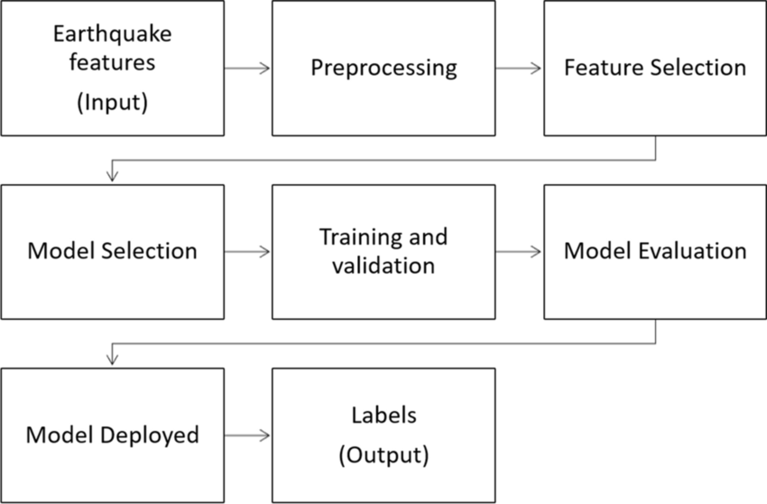
System design – Architecture diagram

Slide 9
Implementation steps
System Architecture
Input: Satellite data, IoT sensors, public datasets.
Processing: Cloud-based server for data preprocessing, model training, and inference.
UI: Flask and Streamlit web app for real-time visualization and alerts.
Key Modules
Data Ingestion: Real-time and batch data collection via APIs.
Preprocessing: Noise removal, scaling, and transformation for model readiness.
Feature Extraction: GIS tools for spatial analysis, temporal pattern identification.
Prediction: ML and deep learning models for disaster forecasting.
Visualization: Dashboards with interactive maps and real-time alerts.
Database: SQL/NoSQL for storing processed data and model outputs.
Implementation
Tools: Python, Flask, Streamlit, TensorFlow, Scikit-learn, Matplotlib.
Data Flow: Input → Preprocessing → Feature Engineering → Prediction → Visualization.
Model Training: Hyperparameter tuning, ensemble techniques, and validation.
Web App: User-friendly interface with real-time updates and alerts.
Deployment: Cloud-based deployment on AWS or Google Cloud.
Scalability & Security
Distributed computing and caching for performance.
Data encryption and role-based access for privacy.
This streamlined design ensures efficient disaster prediction and management through scalable and secure systems.

Slide 10
Hardware and Software Details
Hardware and Software Details
Hardware Requirements
Processor: Multi-core (e.g., Intel Xeon, AMD Ryzen)
RAM: Minimum 8 GB
Storage: SSD, at least 512GB
Network: High-speed internet (100 Mbps or more)
Software Requirements
Operating System: Windows Server
Programming Languages:
Development Tools:
Machine Learning
Libraries: Scikit-learn for basic algorithms; TensorFlow,opencv,image processing,OCR for advanced models (if needed).Database
Options: MySQL or PostgreSQL (SQL) for structured data, and MongoDB (NoSQL) for unstructured data.

Slide 11
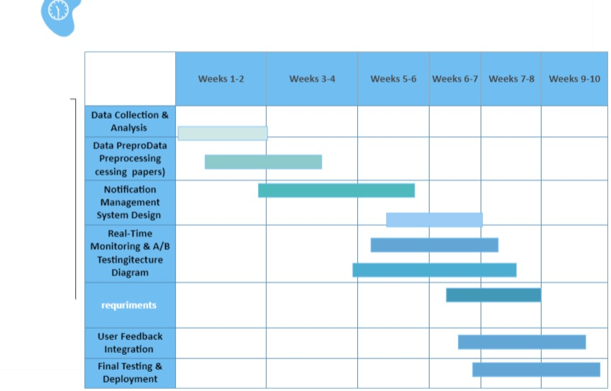
Timeline of project - GHANT CHART

Slide 12
Expected Outcomes
The project aims to enhance disaster management by integrating diverse data sources and leveraging advanced predictive algorithms. It will enable proactive decision-making, allowing authorities to take preemptive actions such as evacuations and resource mobilization. A real-time alert system will provide critical information to communities, reducing loss of life and property. Post-disaster modeling will offer insights into disaster progression, optimizing resource allocation and rescue operations while supporting recovery efforts.
The system will utilize machine learning to predict disasters like floods, earthquakes, and wildfires by processing satellite imagery, sensor data, and human inputs. It will feature a real-time monitoring dashboard for dynamic updates and alerts, improving preparedness. Additionally, the system will model post-disaster spread dynamics, ensuring efficient disaster recovery and providing a scalable framework adaptable to various disasters and regions.

Slide 13
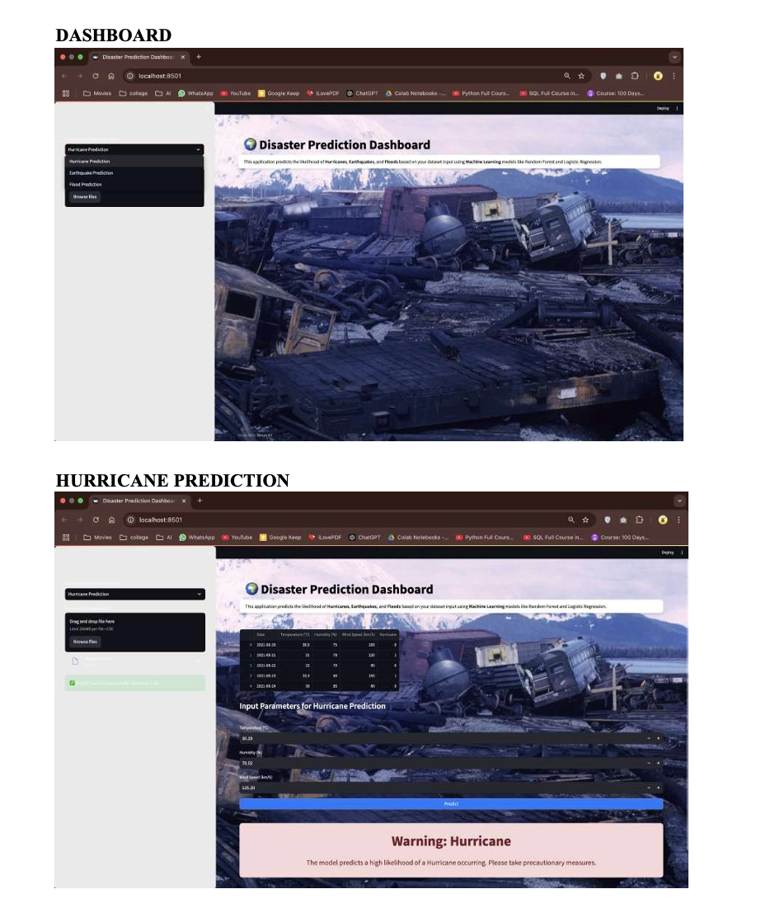
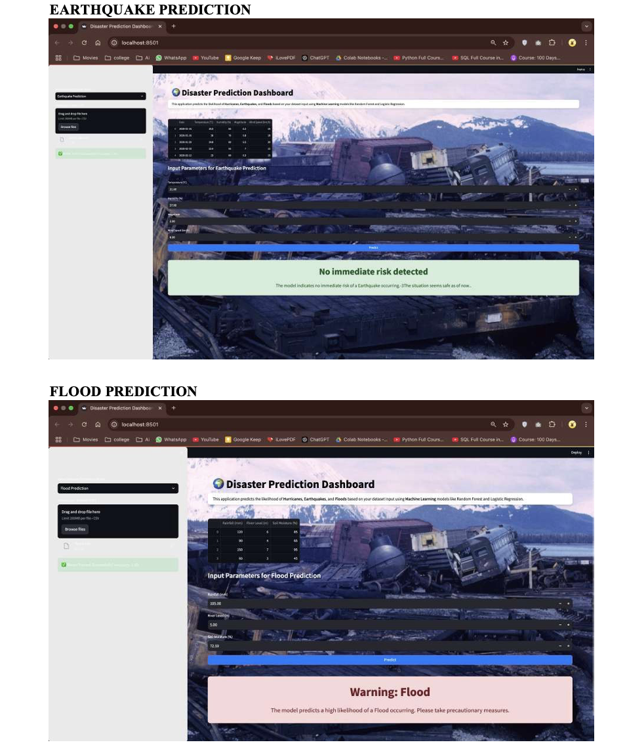
Results

Slide 14
Conclusion
In conclusion, this project aims to develop an innovative disaster prediction and post-disaster management system that leverages satellite data, sensor inputs, and human-generated information to accurately forecast large-scale natural disasters. By integrating machine learning and geospatial analysis, the system will provide real-time monitoring, timely alerts, and comprehensive models of disaster spread dynamics, aiding in effective disaster preparedness and management. The solution is designed to support authorities in making data-driven decisions, optimize resource allocation, and minimize the social, environmental, and economic impacts of disasters. With its scalable and adaptable framework, this project holds the potential to improve global disaster response strategies and reduce the devastation caused by natural disasters in various regions.
Accurate Disaster Prediction: The system will use machine learning to process satellite and sensor data, enabling early detection of natural disasters like floods, earthquakes, and wildfires.
Real-Time Monitoring and Alerts: A dynamic dashboard will continuously track disaster risks, providing real-time updates and issuing timely alerts to improve disaster preparedness.
Post-Disaster Spread Modeling: The project will model how disasters spread, helping authorities manage resources, plan evacuations, and optimize recovery efforts.
Scalable and Adaptable Framework: The solution will be scalable, adaptable to different disaster types and regions, enhancing global disaster response and management.

Slide 15
References
Smith, A., & Johnson, B. (2018). "Satellite Data for Natural Disaster Prediction: A Comprehensive Review." International Journal of Remote Sensing, 39(2), 245-260.
Li, C., & Chen, H. (2019). "Real-Time Monitoring Systems for Disaster Management Using IoT." IEEE Internet of Things Journal, 6(4), 765-777.
Kaur, R., & Singh, P. (2021). "Post-Disaster Recovery Models Using Geospatial Data." Journal of Disaster Risk Reduction, 10(3), 405-419.
Brown, T., & Patel, S. (2020). "Machine Learning for Earthquake Prediction Using Sensor Data." Journal of Applied Earth Observations and Remote Sensing, 14(7), 533-550.
Wang, X., & Liu, J. (2018). "Integrating Social Media Data into Disaster Response Systems." Information Systems Frontiers, 20(5), 1101-1114.
Gonzalez, M., & Ahmed, Z. (2021). "Geospatial Analysis for Flood Prediction and Management." Journal of Hydrology and Environment, 55(2), 210-226.
Lee, H., & Kim, S. (2020). "Early Warning Systems for Natural Disasters Using Big Data Analytics." Journal of Information Technology Research, 14(3), 120-136.
Singh, V., & Sharma, K. (2019). "Predictive Modeling of Wildfire Spread Using Deep Learning." International Journal of Wildland Fire, 28(11), 953-962.
Miller, J., & Thompson, L. (2020). "Disaster Risk Management Through Remote Sensing Technologies." Remote Sensing in Earth Science, 12(8), 1356-1370. Nguyen, D., & Wang, M. (2019). "A Hybrid Model for Flood Prediction Using Machine Learning and Hydrological Data." Water Resources Management, 33(5), 1829-1845.

Slide 16
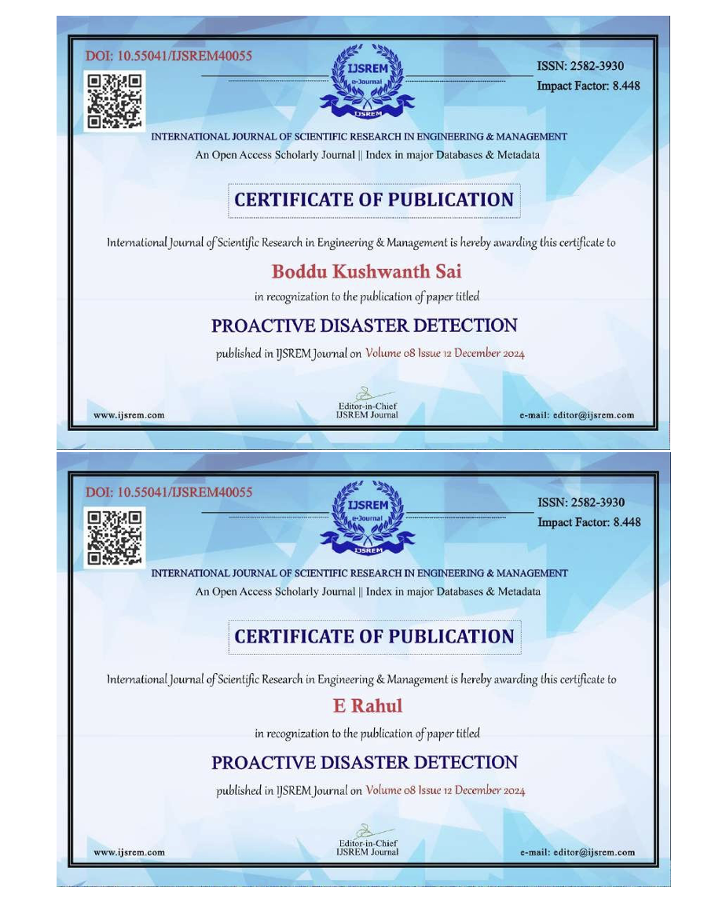
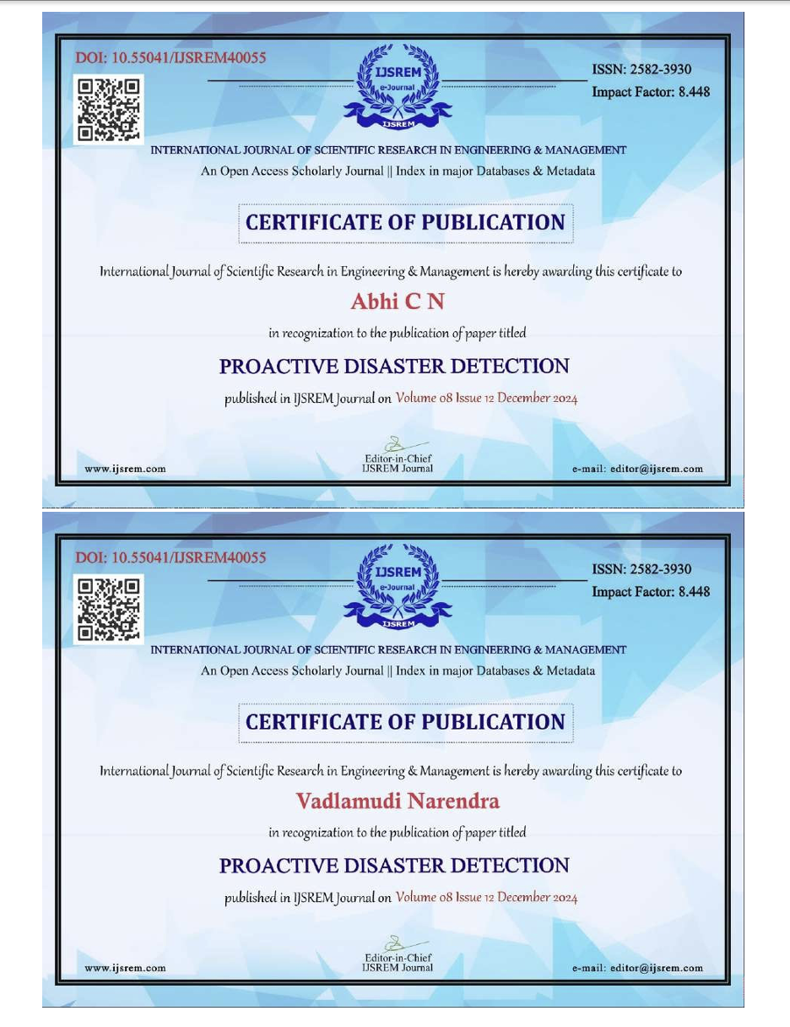
Publication

Slide 17


